Slide 1
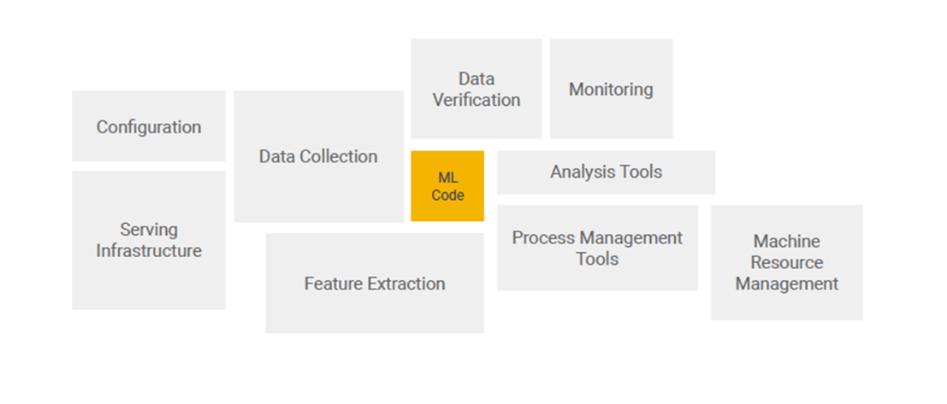
Machine learning - Real world ml systems
Source - https://papers.nips.cc/paper/2015/file/86df7dcfd896fcaf2674f757a2463eba-Paper.pdf

Slide 2
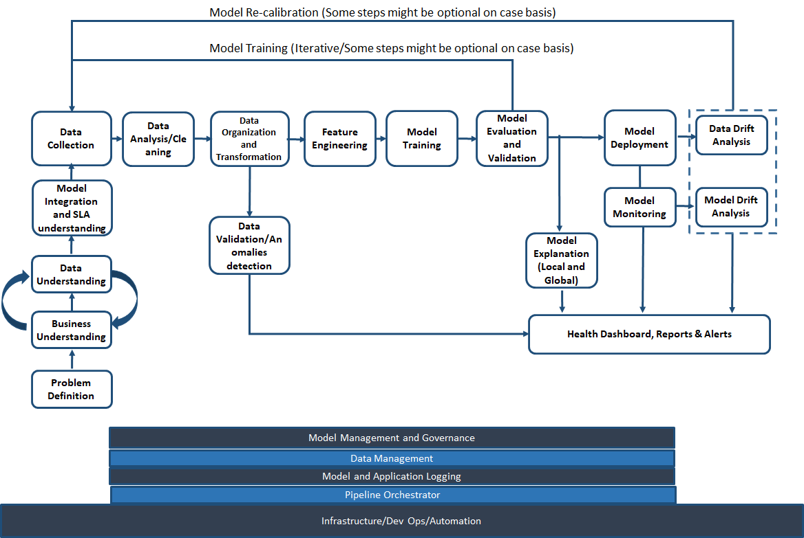
Real world ML process

Slide 3
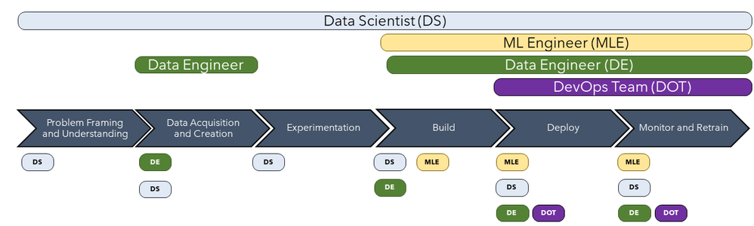
Challenges with people and process in ML
Skill mismatch between Data Engineers, Data Scientist and Software/DevOps Engineers
Image Source - https://techcommunity.microsoft.com/t5/azure-ai/mlops-is-not-enough/ba-p/1386789

Slide 4
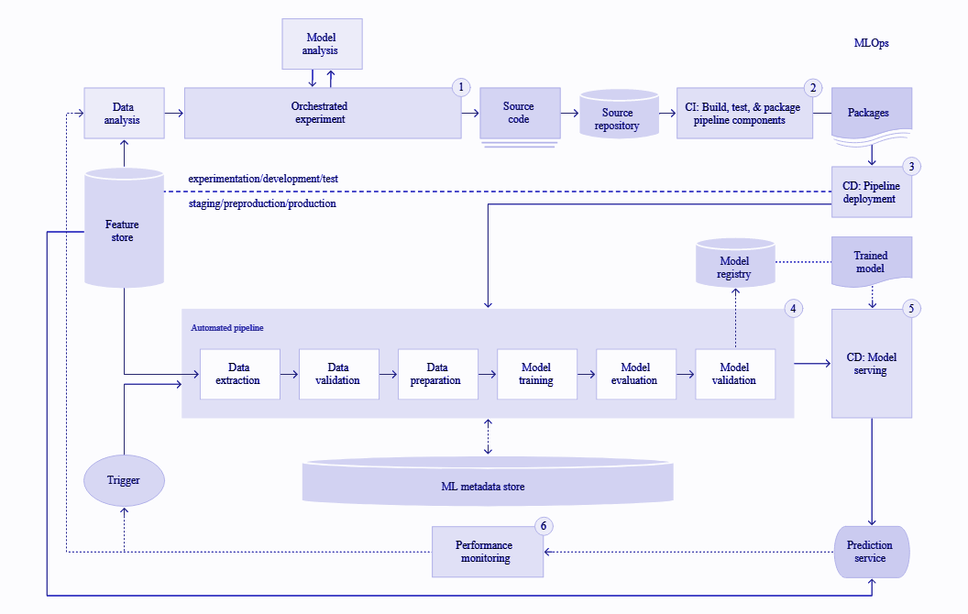
MLOps Automated pipeline and components

Slide 5
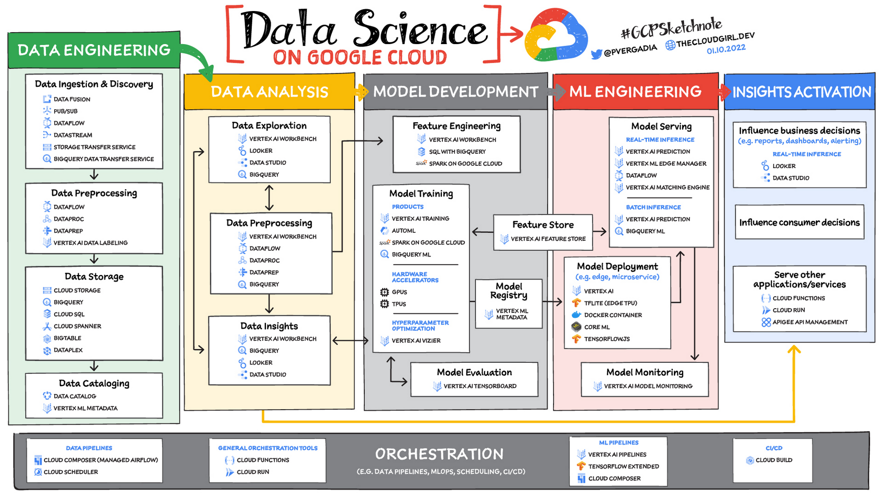

Slide 6
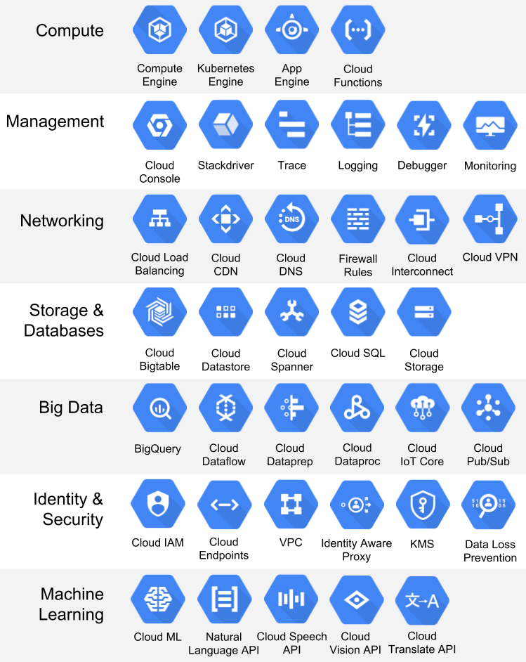

Slide 7
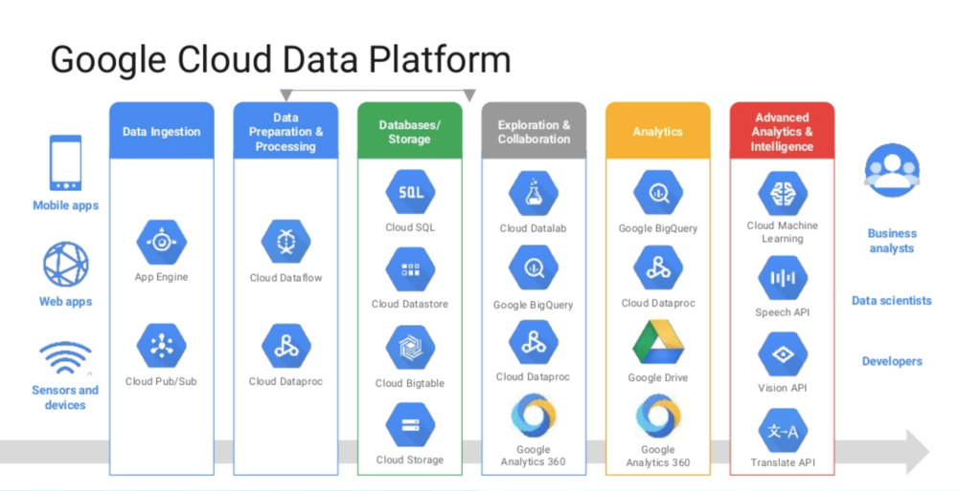

Slide 8
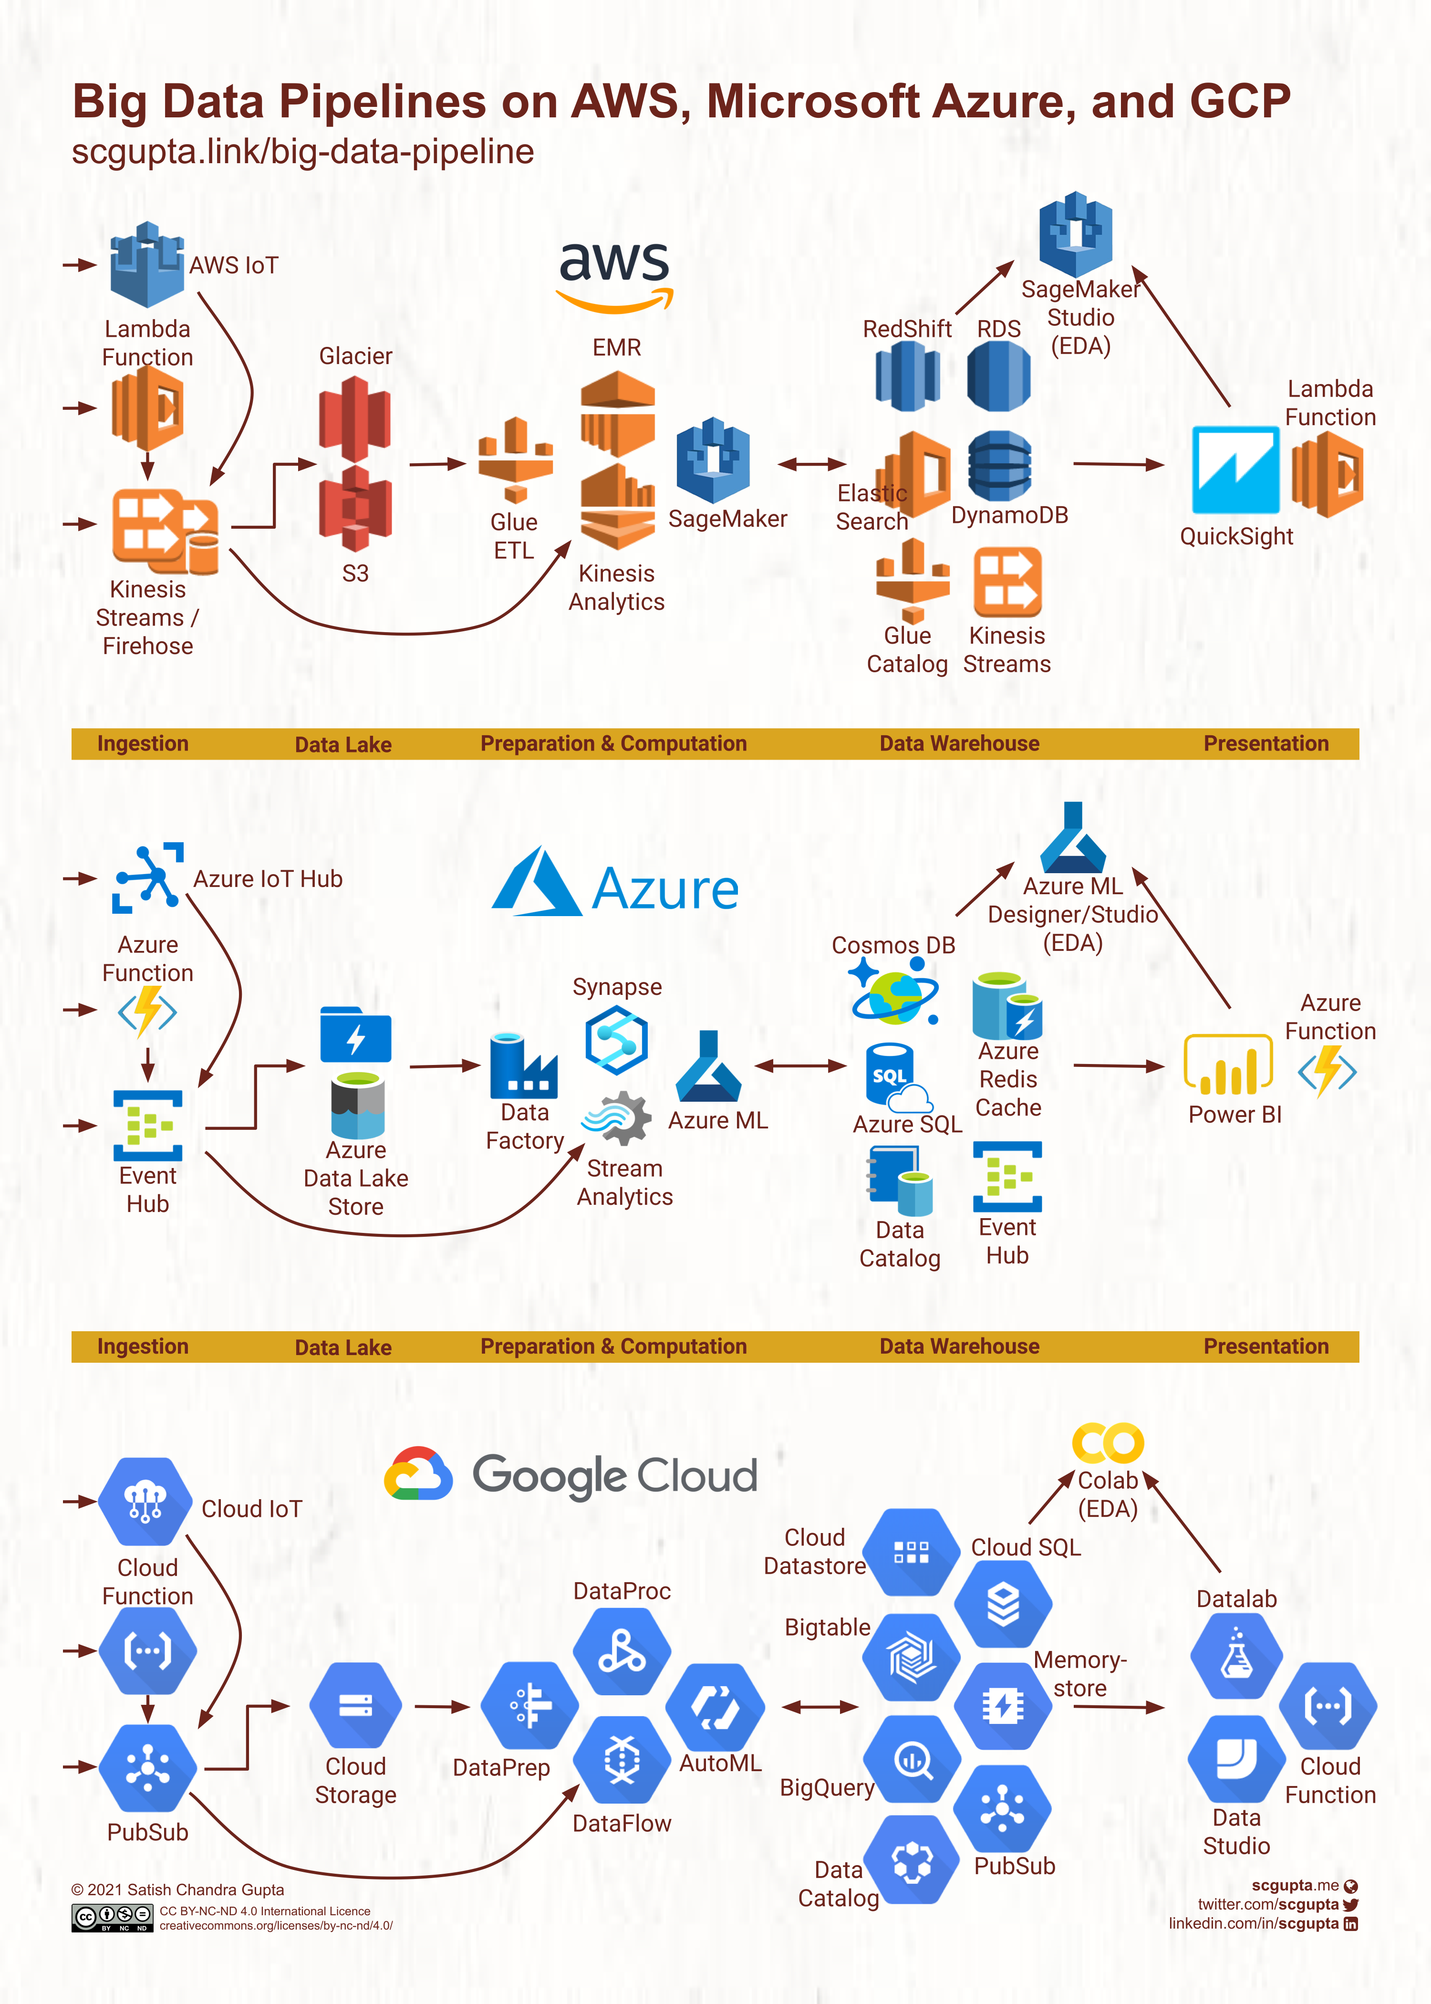

Slide 9
